Slide 1
Work Force management system
Skilled, semi-skilled and Unskilled

Slide 2
Problem statement
Design and develop a comprehensive Workforce Management System using the MERN (MongoDB, Express.js, React, Node.js) stack, to connect users with skilled, semi-skilled, and unskilled workers efficiently. The system allows users to search for workers based on their specific requirements.

Slide 3
Functional requirements
1) User Authentication
2) Homepage
3) Dashboard
4) Worker/Employee Listings
5) User Management
6) Cart Management
7) Appointment Placement
8) Admin Panel

Slide 4
User authentication
Users can register for an account with their email, password ,username and pincode .
Registered users can log in to the platform using their credentials
Passwords will be securely hashed and stored in the database

Slide 5
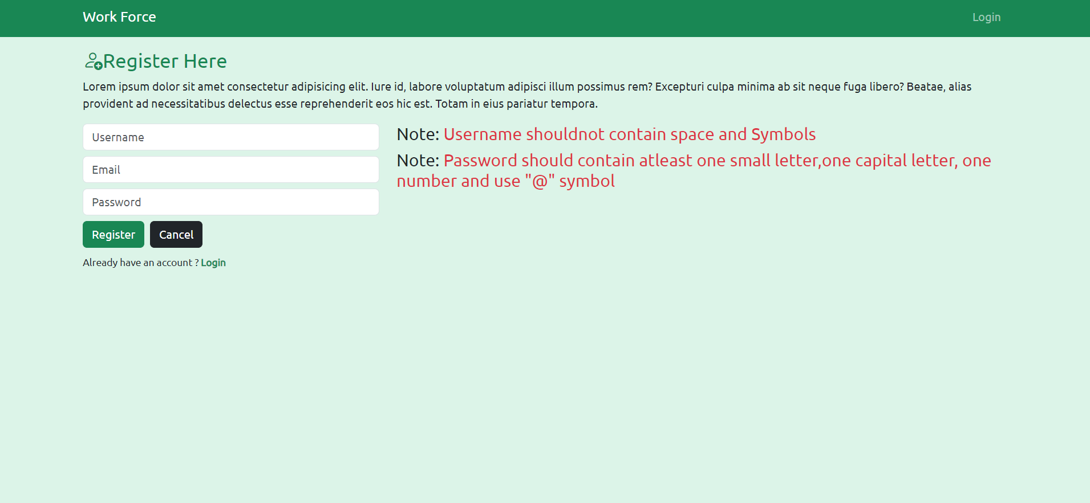
Home Page
The homepage will present users with a login option and a registration option for new users
After logging in, users will be directed to their dashboard.
Registration process for workers initiated by the administrator to prevent fake accounts and ensure the authenticity of workers

Slide 6
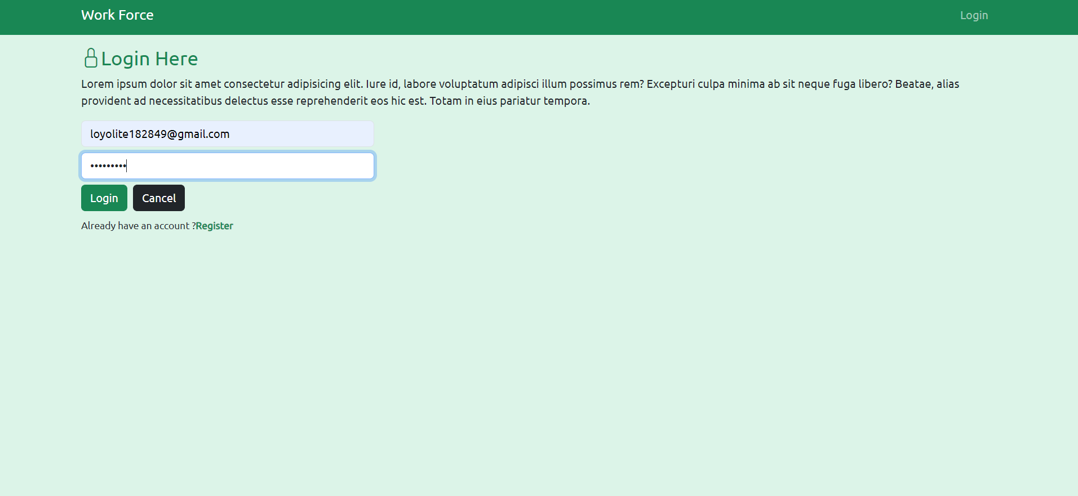

Slide 7


Slide 8
DASHBOARD
The user dashboard will include a navigation bar and an off canvas for filtering workers.
The navigation bar will offer links to different worker categories and user-specific options
The off canvas will allow users to filter subcategories based on their requirement and apply filters

Slide 9
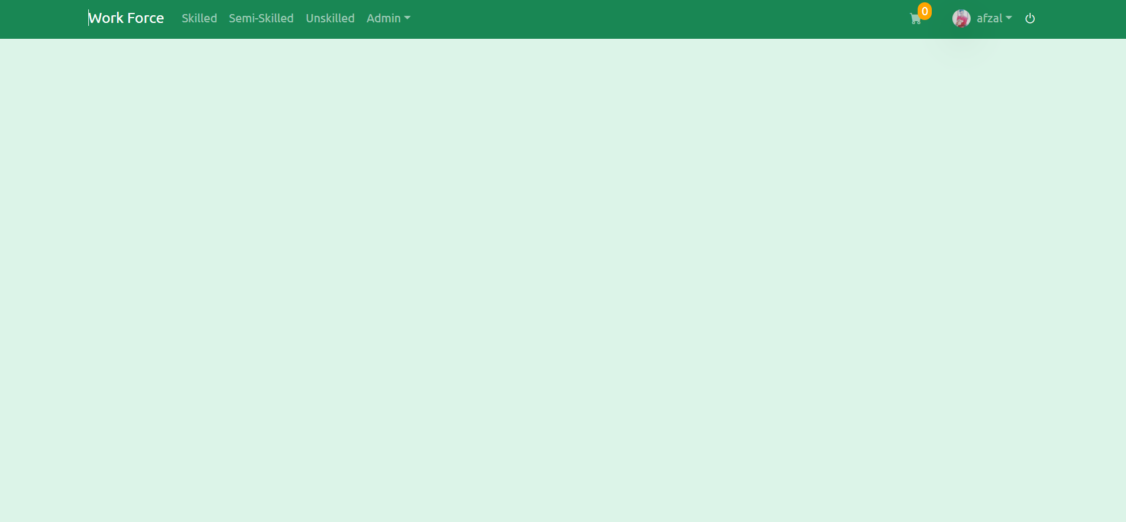

Slide 10
Worker listings
Workers will be categorized into categories such as skilled workers, semi skilled workers and unskilled workers.
Here each category consists of subcategories which says worker profession.
Off canvas will provide filtering options which makes user to filter specific profession based on his/her requirement.
Users can view worker details and add them to their cart

Slide 11
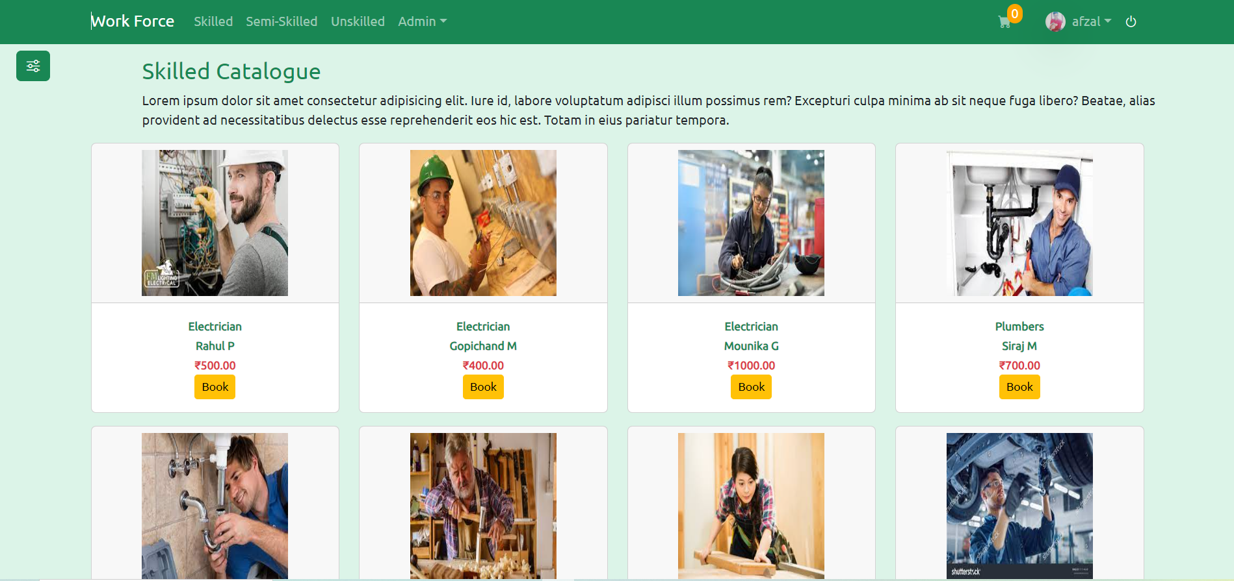

Slide 12
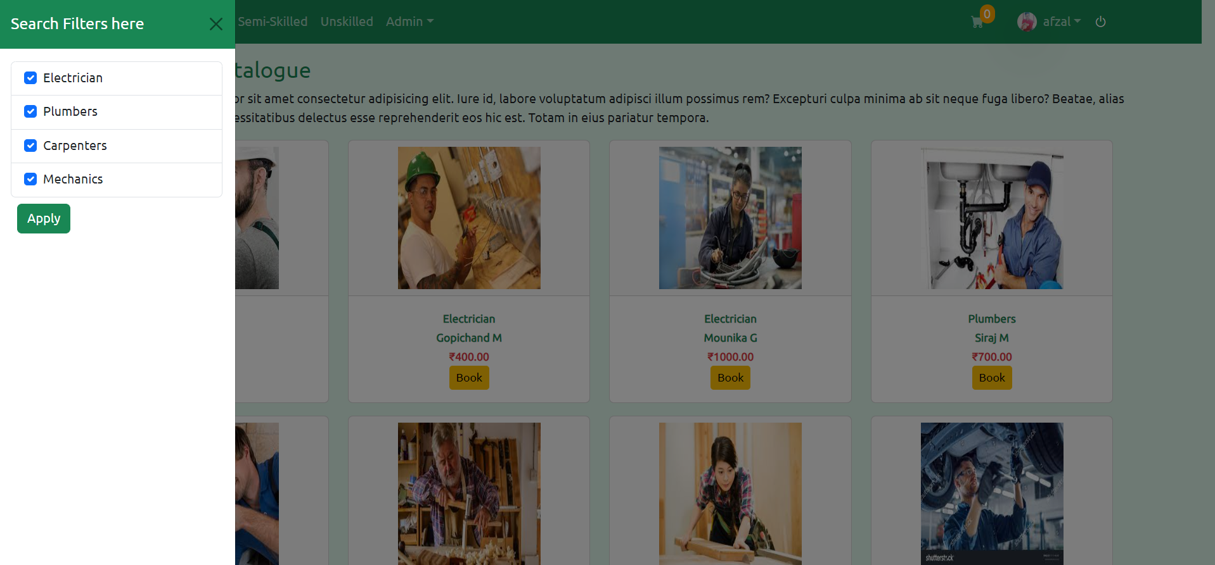

Slide 13
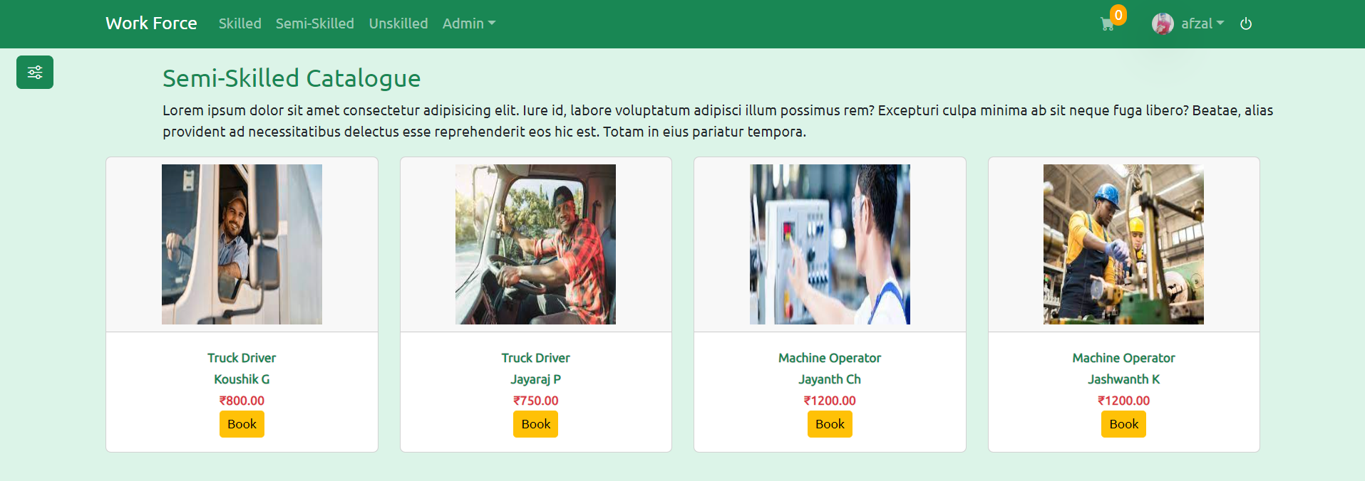

Slide 14
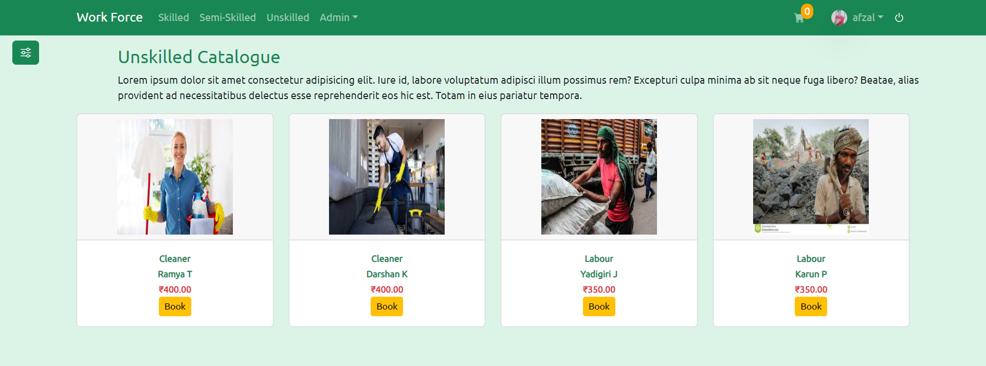

Slide 15
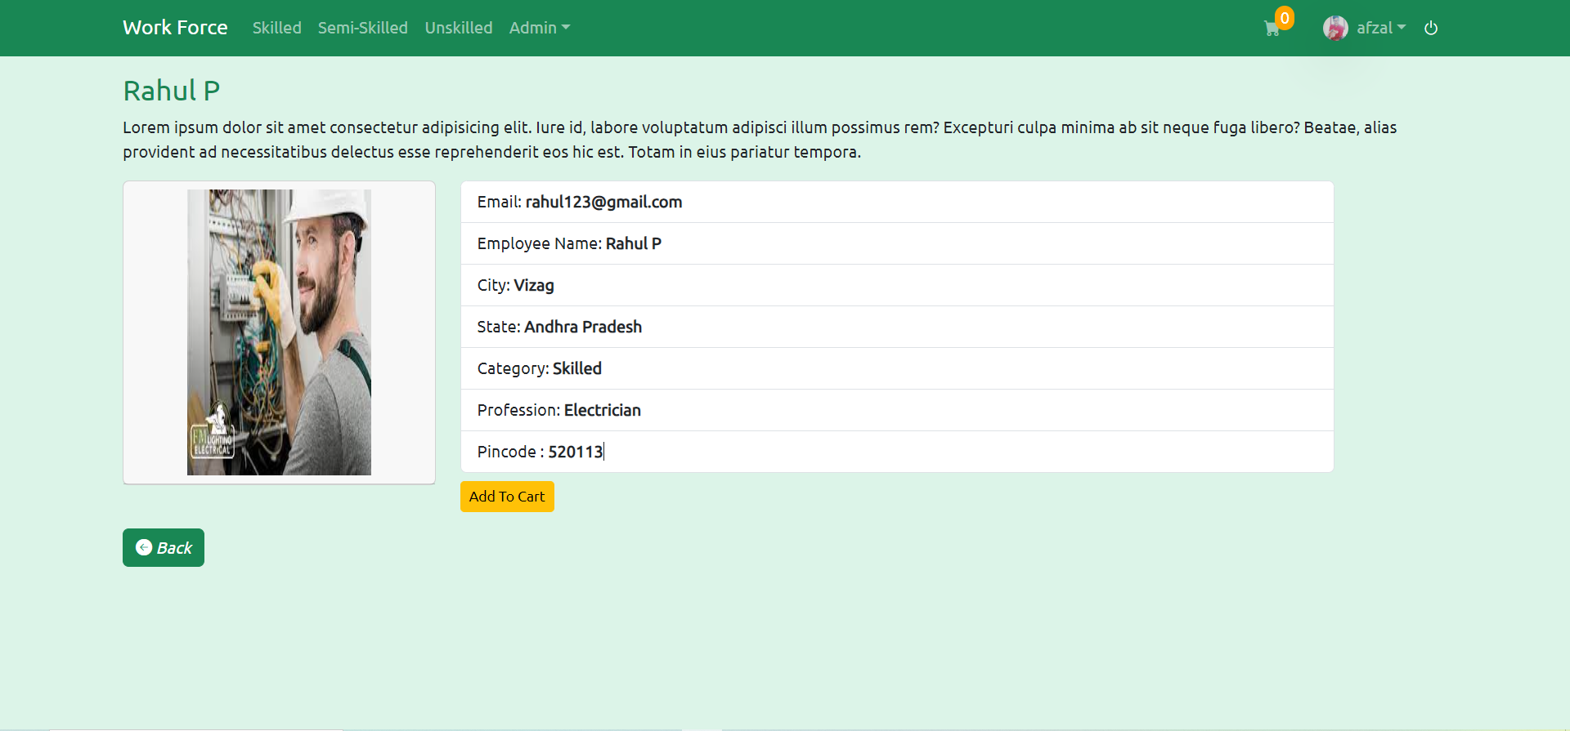

Slide 16
User management
Users can update their profile picture and change their password
Implement a seamless address selection process during the checkout phase ensuring secure storage of location details and providing an efficient way for workers to reach users' specified locations
Users can view their appointment history .

Slide 17
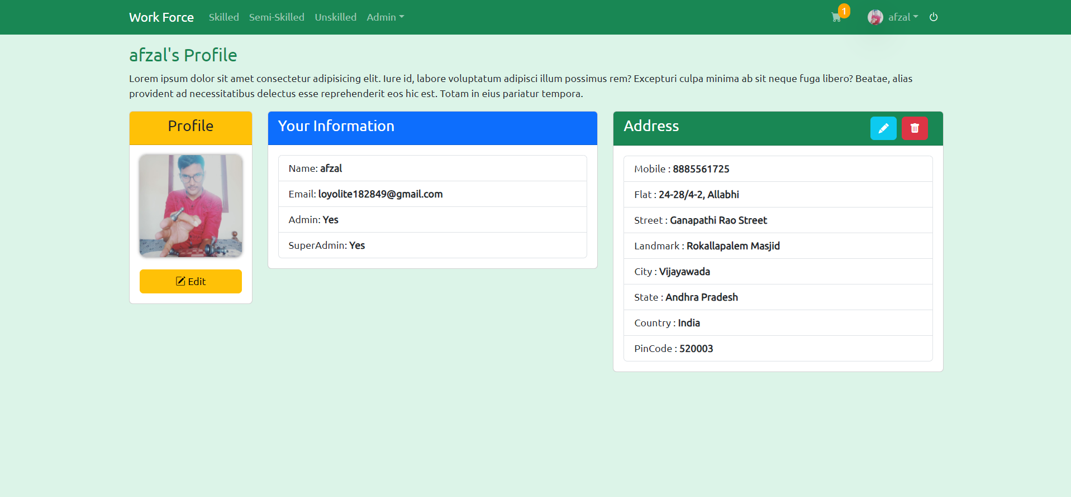

Slide 18
Cart management
Users can add workers to their cart
Users can view and manage the contents of their cart
Users can delete workers from their cart.
Users have to select one worker and proceed to checkout from the cart

Slide 19
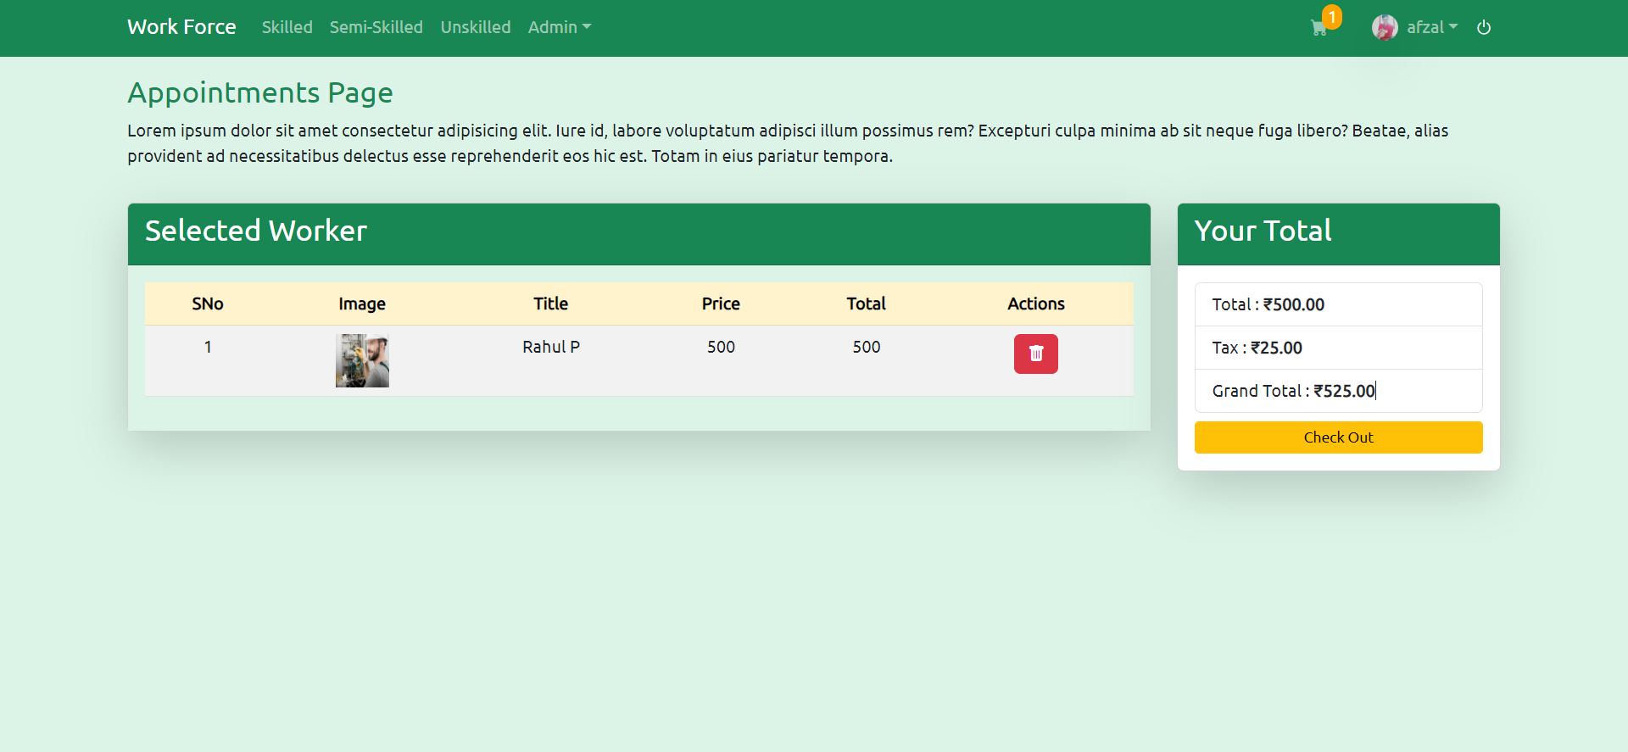

Slide 20
Appointment placement
Users can book appointment from the checkout page.
Users will provide address details and select a payment method
Appointments will be stored in the database with status and payment details
User can check their appointments and appointment status are updated by time to time

Slide 21
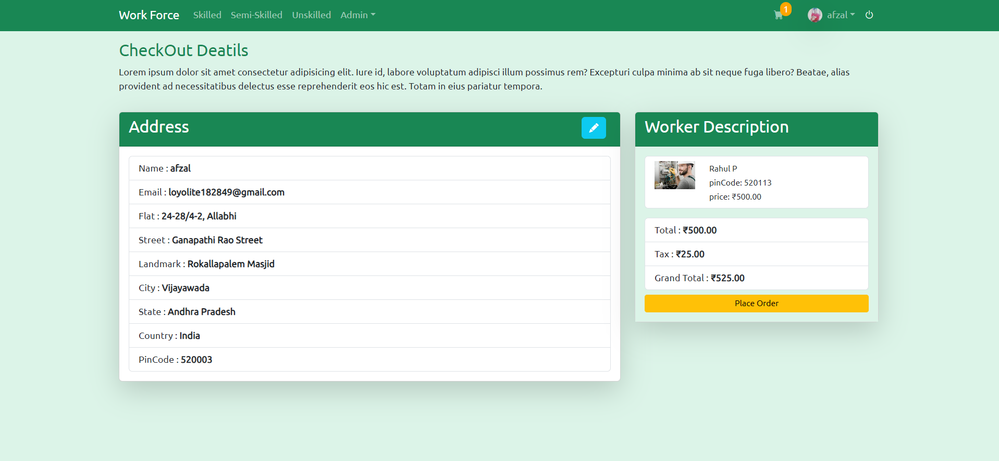

Slide 22
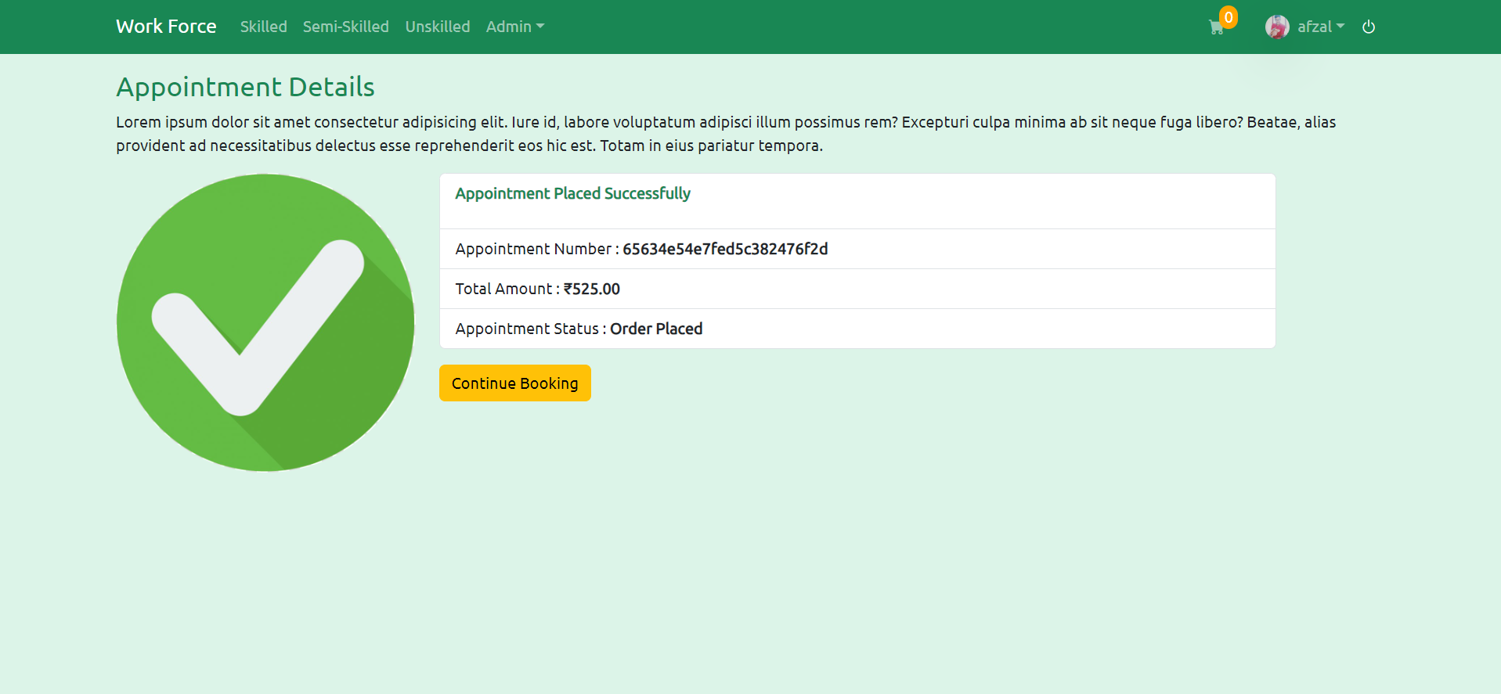

Slide 23
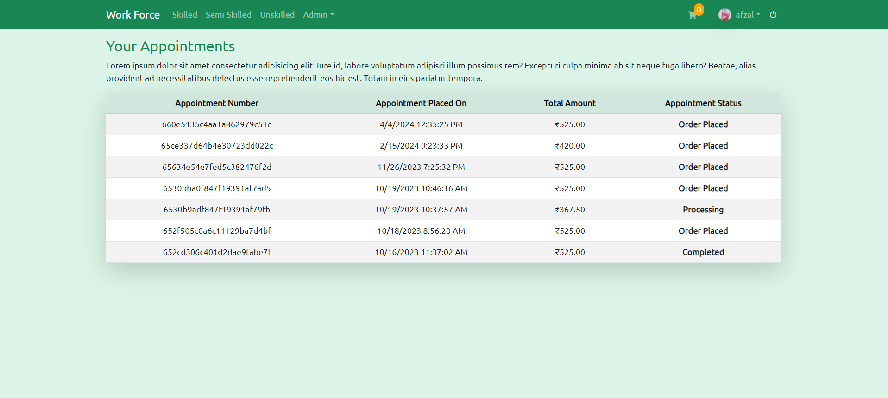

Slide 24
Admin panel
Admin users will have access to a drop-down menu for managing categories, workers, and appointments.
Admins can add new categories and subcategories
Admins can manage worker details and availability
Admins can view and manage user appointments

Slide 25
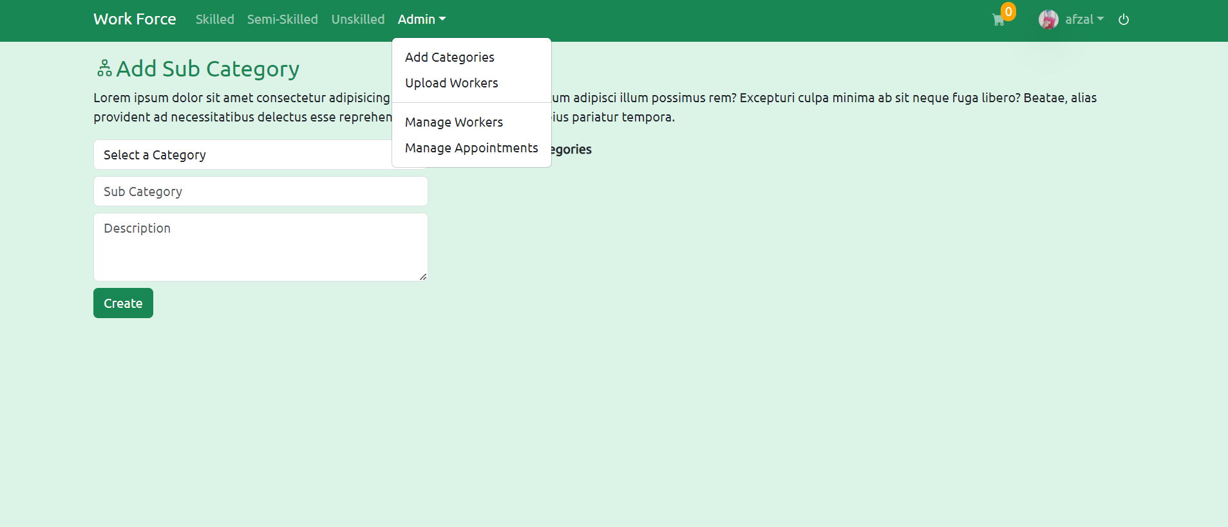

Slide 26
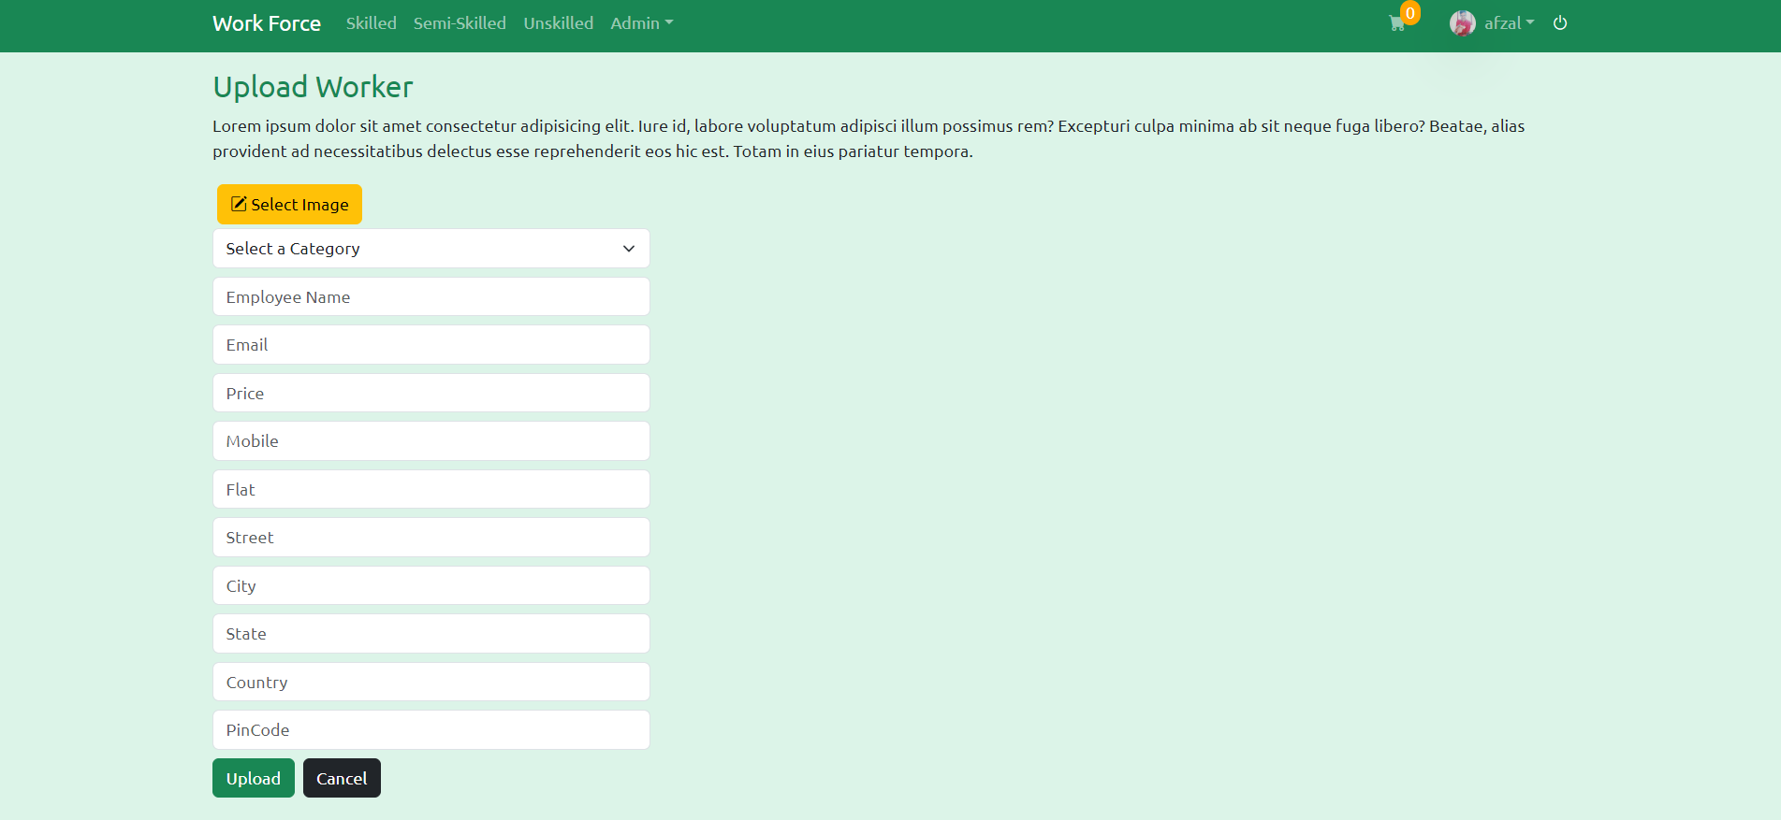

Slide 27
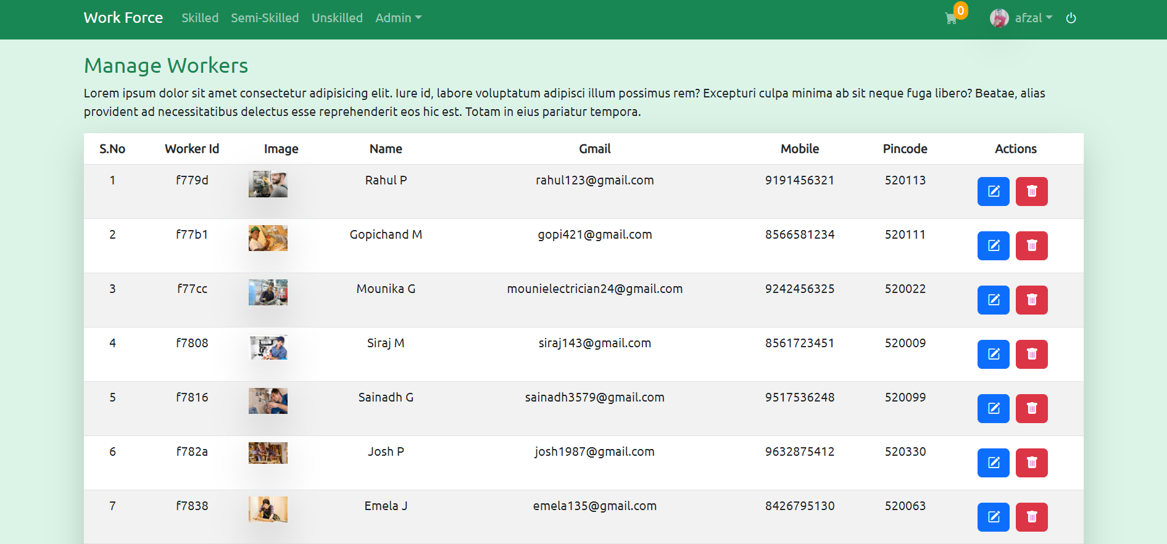

Slide 28
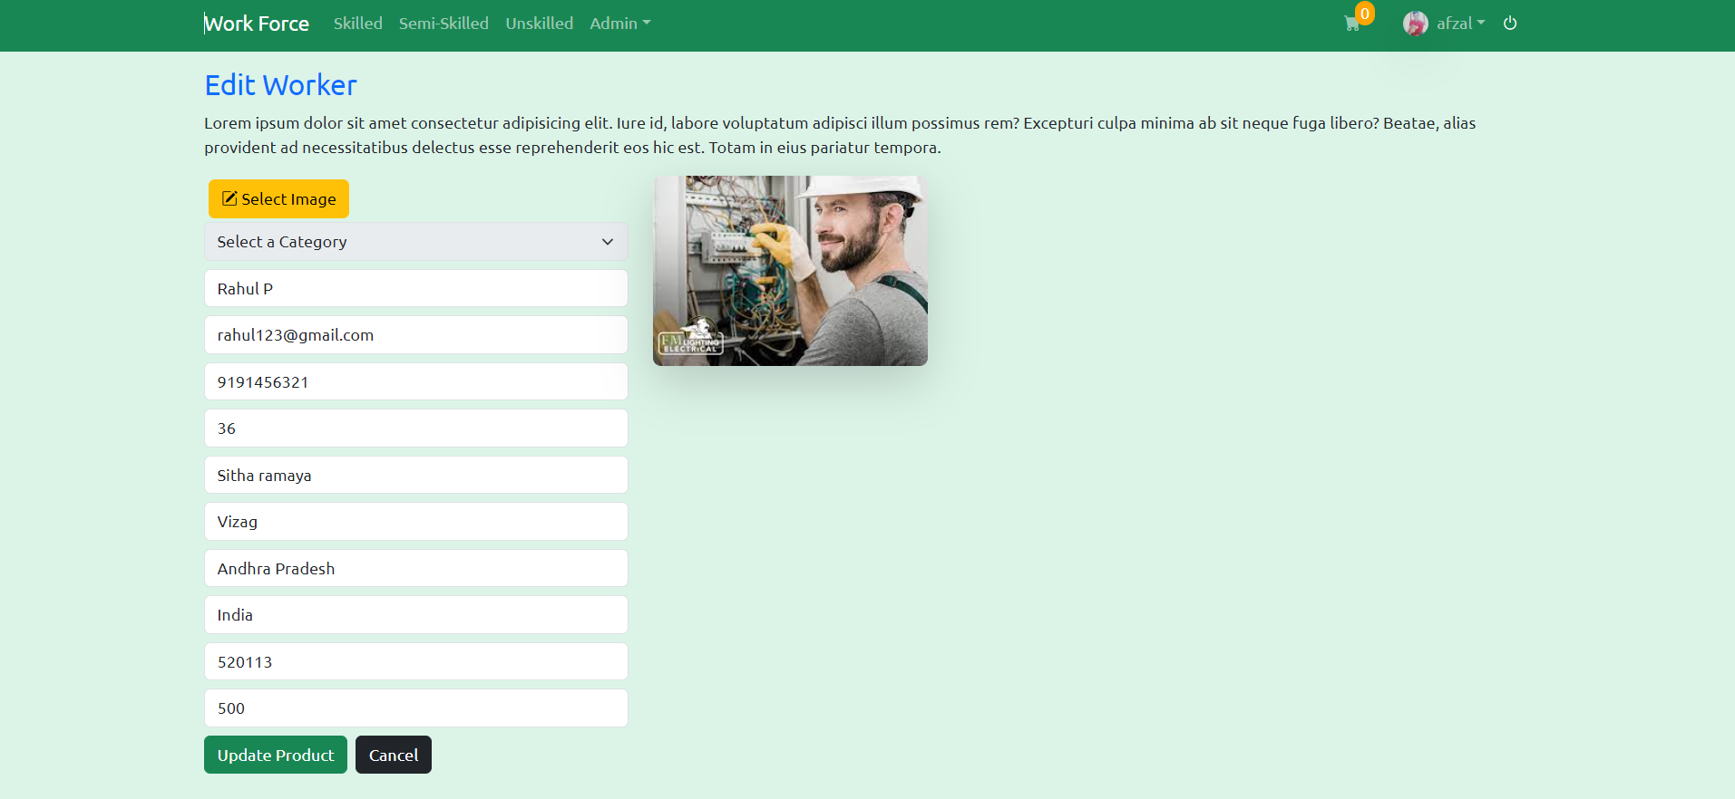

Slide 29
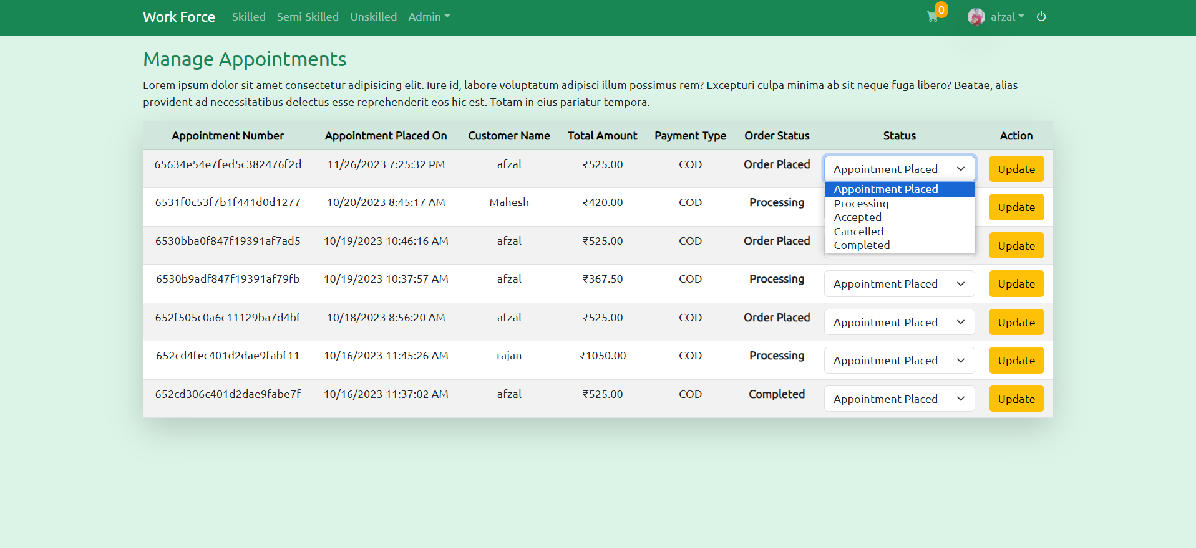

Slide 30
Non-functional requirements
1) Security:
Implement a secure user authentication system to ensure that only authorized users can access the platform
JWT authentication and authorization will be implemented for user access control. Passwords are hashed and stored
2) Performance:
The website uses MongoDB to quickly load workers, ensuring speedy access to information for efficient management.

Slide 31
Non-functional requirements
3) User Flexibility:
The user interface should be intuitive and responsive
Filter options should be user-friendly and easy to apply

Slide 32
Technology stack
Frontend: React, React Router, Bootstrap
Backend: Node.js, Express.js, MongoDB
User Authentication: JWT (JSON Web Tokens)
State Management: Redux Toolkit
UI Components: React Bootstrap
API Communication: Axios

Slide 33
Database tables
Users
Addresses
Categories
Subcategories
Workers
Carts
Appointments

Slide 34
Email Notification
Email Notification:
Upon user registration and successful login, an email notification is sent via Nodemailer, welcoming the user to the platform.
Integrate an email notification system to send confirmation emails to users after registration and appointment booking using node mailer, ensuring timely communication

Slide 35
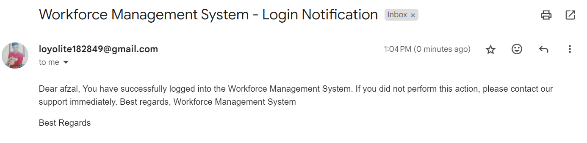

Slide 36
Search Bar
Search Bar:
Implement a search bar feature allowing users to type in the desired worker profession. Upon submission, workers matching the specified profession are filtered, providing users with tailored results. This enhances user experience by facilitating efficient exploration and selection of workers based on their specific needs.

Slide 37
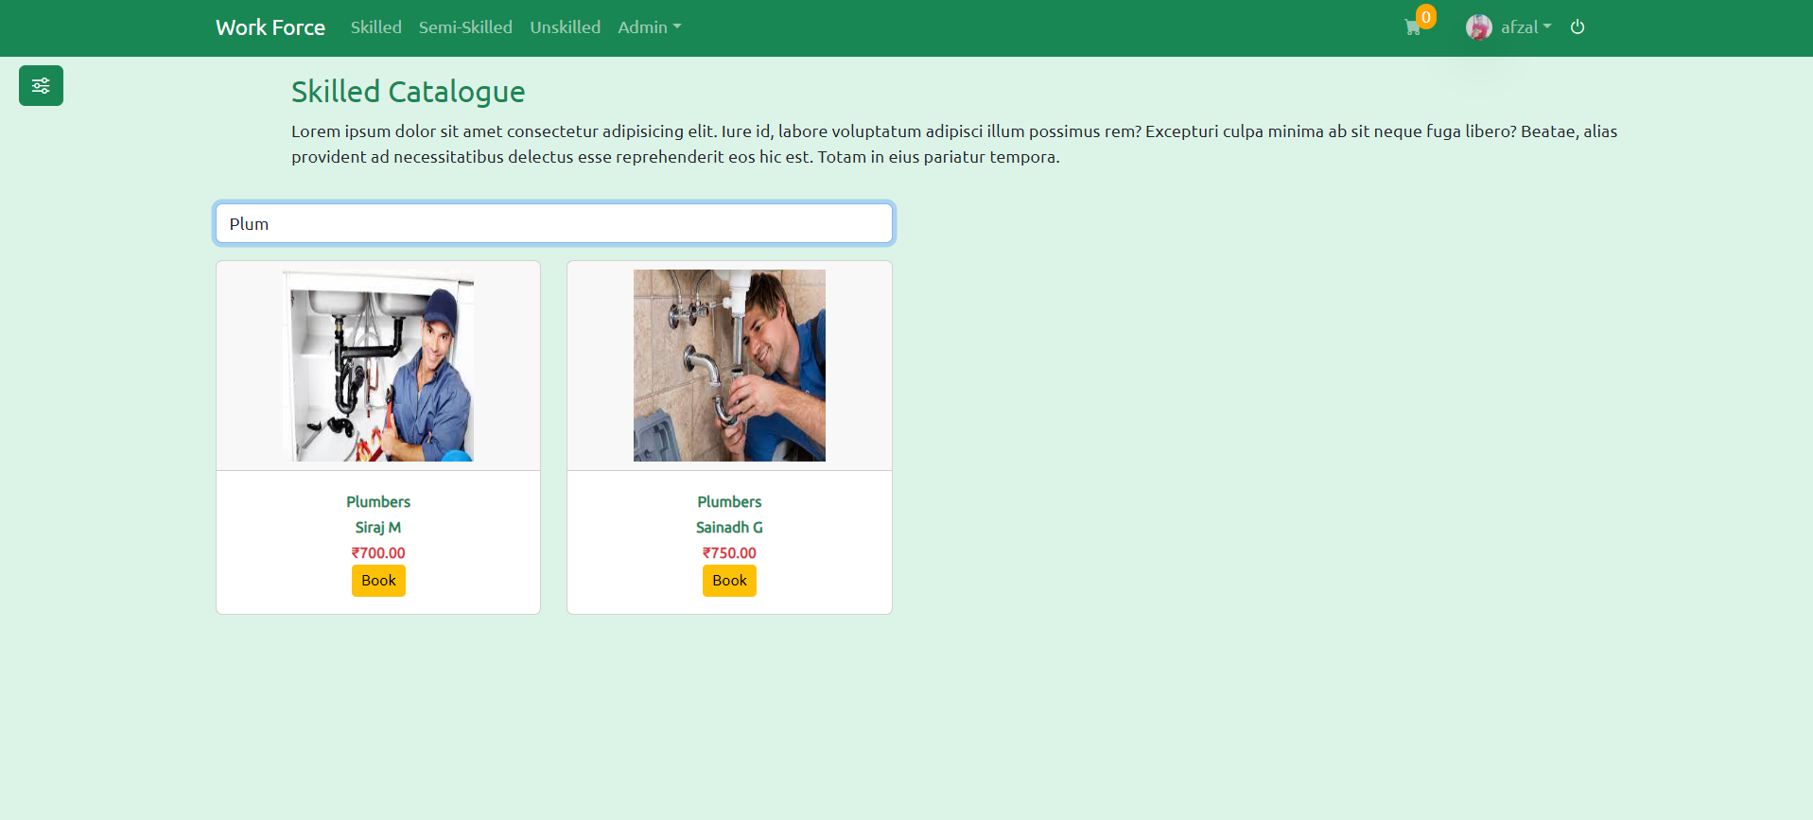

Slide 38
Selecting Cities and Filtering Workers
Importing Cities:
Our application begins its journey by incorporating a cities file, which acts as a reservoir of diverse urban destinations. This file encompasses a vast array of cities worldwide, forming the backbone of our platform's geographical data. Through importing this file, users gain access to an extensive selection of cities, each representing a unique cultural, historical, and geographical identity. This resource empowers users to navigate and explore cities of interest seamlessly.. In essence, the cities file serves as a foundational element, enriching our platform's functionality and providing users with a gateway to discover the world's cities.

Slide 39
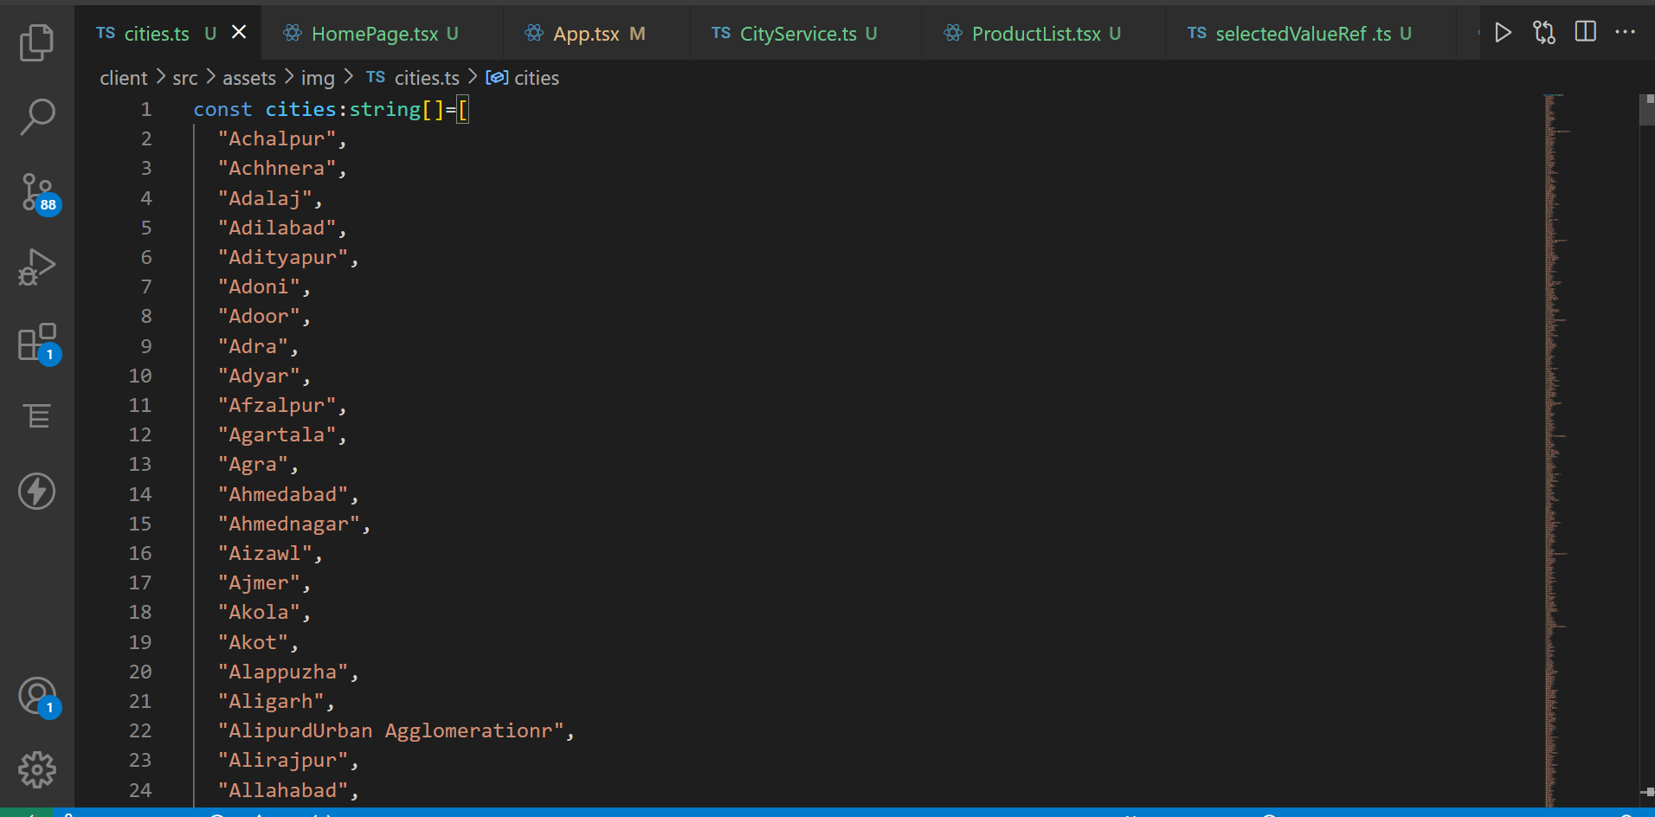

Slide 40
Selecting Cities and Filtering Workers
Selecting a City:
User Interaction: Users are presented with a list of cities through a radio button interface. Upon selecting a city, the corresponding action is dispatched through Redux to update the selected city state.
Redux Implementation: We utilize Redux to manage the application state, ensuring a single source of truth for the selected city. Actions and reducers are defined to handle city selection events and update the state accordingly.

Slide 41
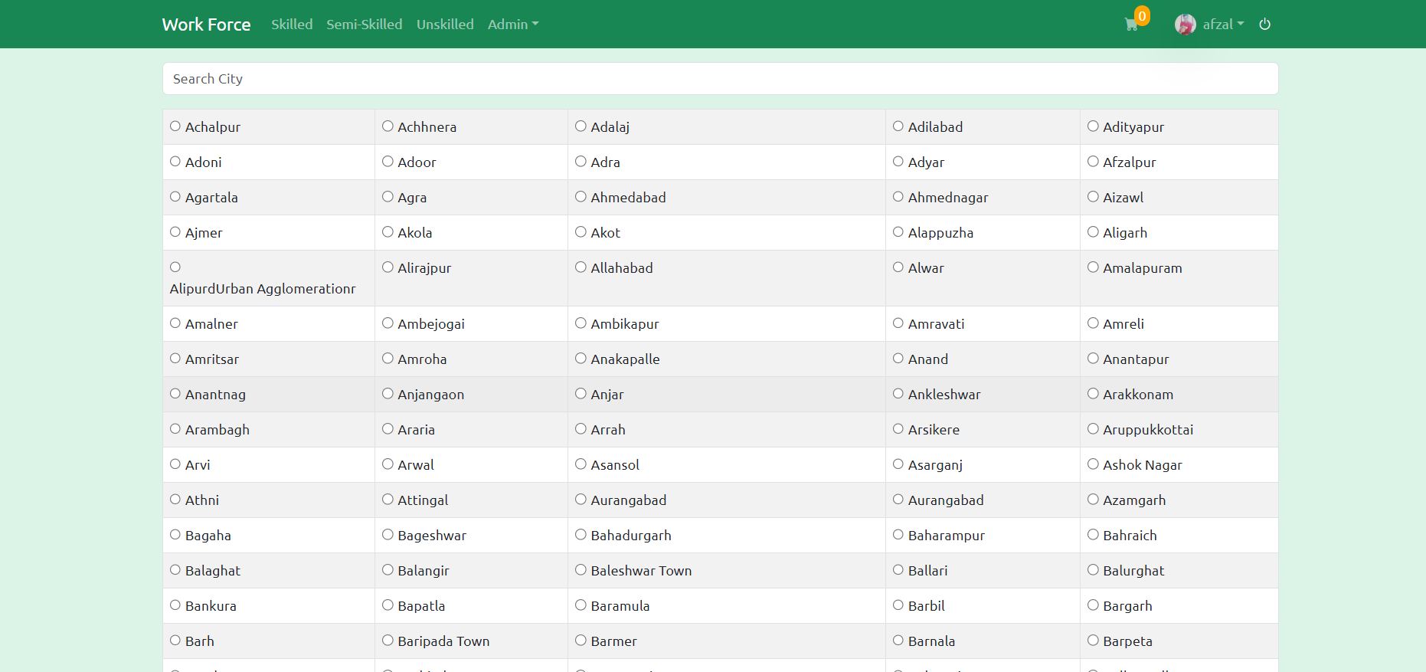

Slide 42
Selecting Cities and Filtering Workers
Search Bar for Cities:
Our platform integrates a search bar feature, enabling users to swiftly filter through cities. Upon typing, the search bar dynamically updates the displayed options, simplifying the selection process. Complementing this functionality are radio buttons, providing a convenient interface for city selection. These buttons, organized neatly in a table layout, ensure easy navigation and selection. Together, the search bar and radio buttons offer a user-friendly experience, allowing users to efficiently explore and choose from the available cities.

Slide 43
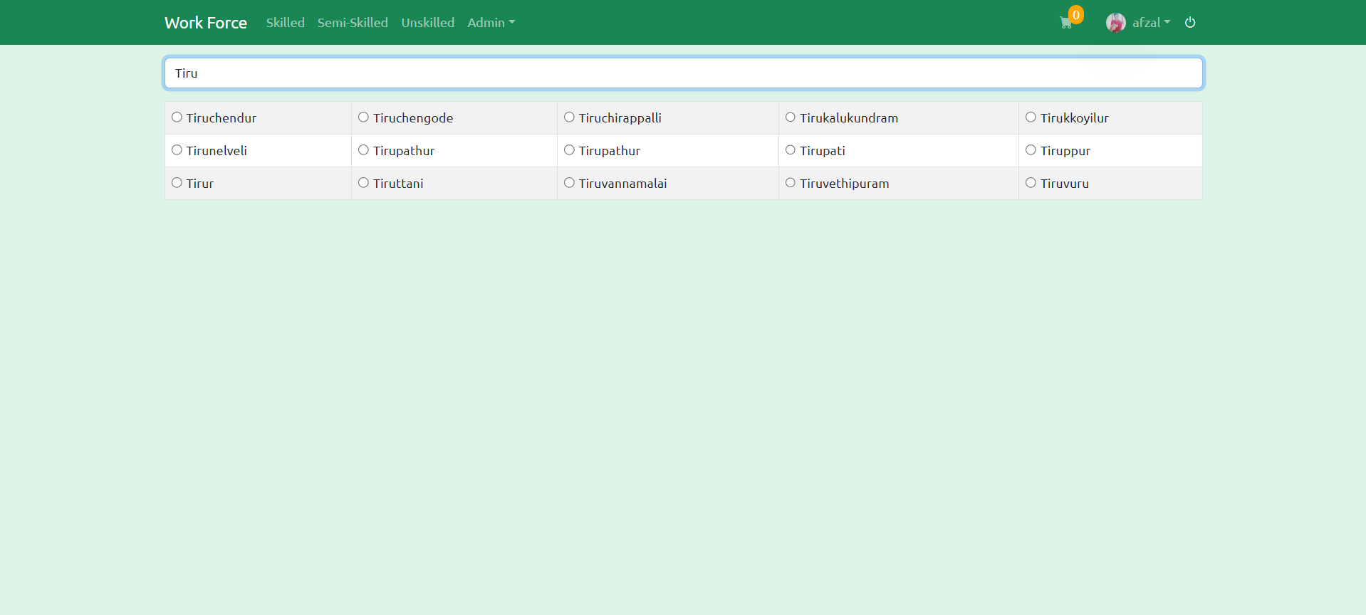

Slide 44
Selecting Cities and Filtering Workers
Filtering Workers:
Displaying Workers: Workers' information is retrieved from the backend and displayed based on the selected city. Redux facilitates the retrieval and management of worker data, ensuring efficient state management and seamless updates.
Search Bar Functionality: A search bar is implemented to enable users to filter workers based on specific criteria. As users type in the search query, the displayed workers dynamically update to match the search criteria.

Slide 45
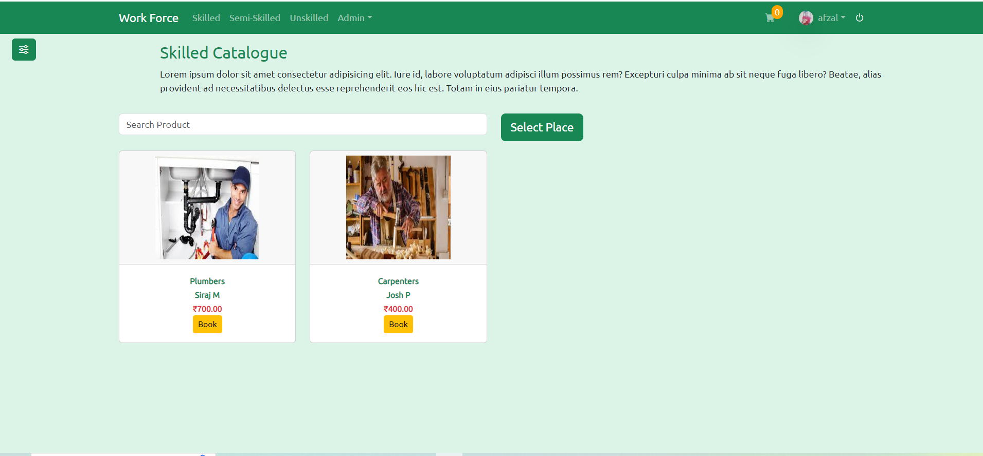

Slide 46
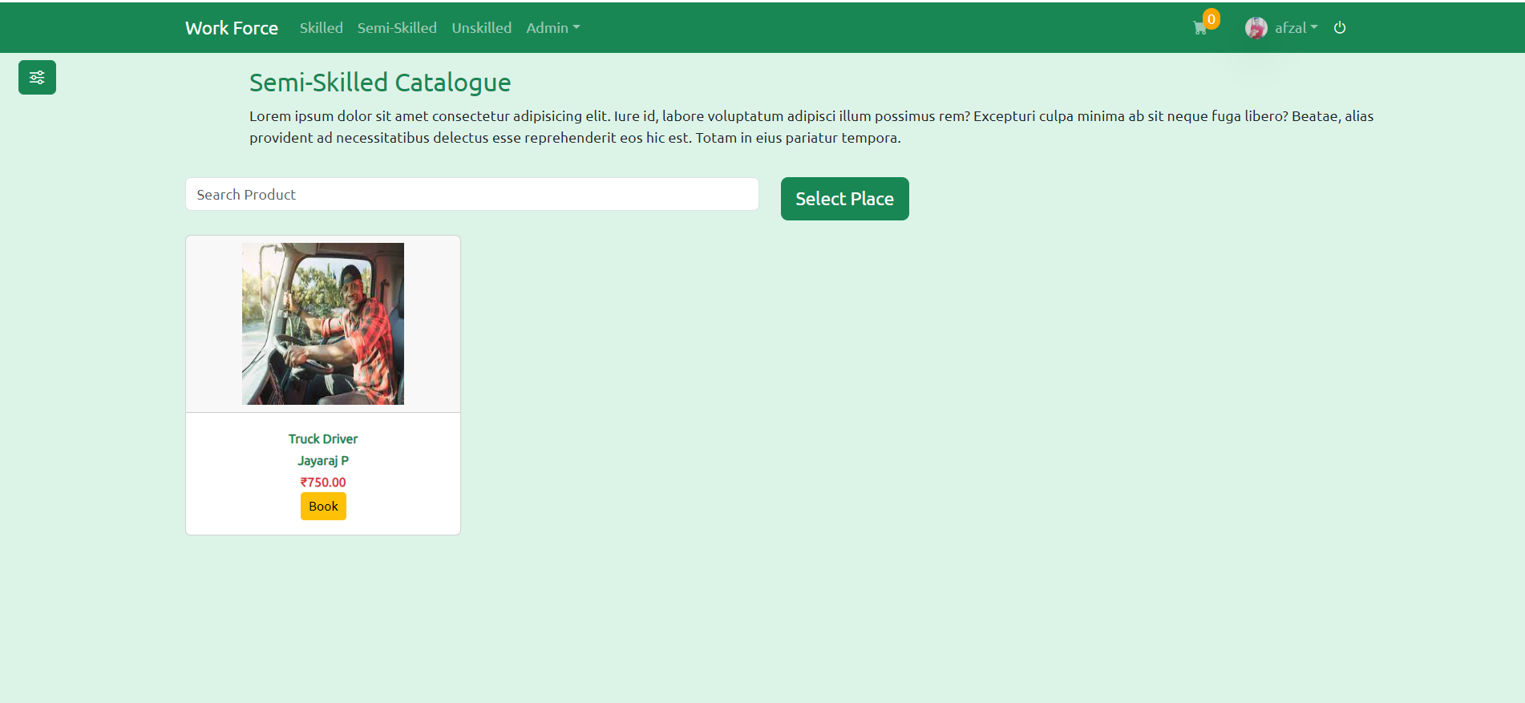

Slide 47
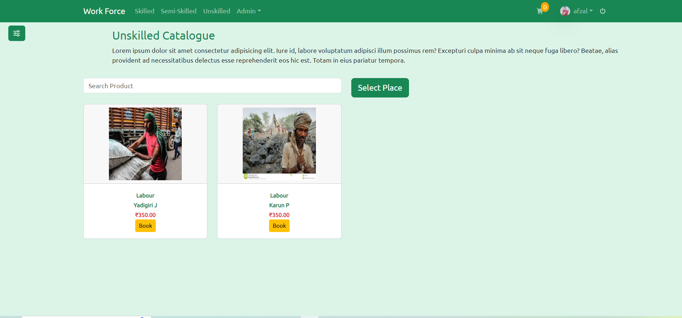

Slide 48
Selecting Cities and Filtering Workers
Select Place:
Our platform now features a "Select Place" button for browsing in skilled, semi-skilled, and unskilled workers catalogues. Upon selection, users are redirected to the cities selection page, empowering them to refine their search location as needed. This intuitive functionality enables seamless navigation between different regions, ensuring users can explore worker profiles in various areas with ease.

Slide 49
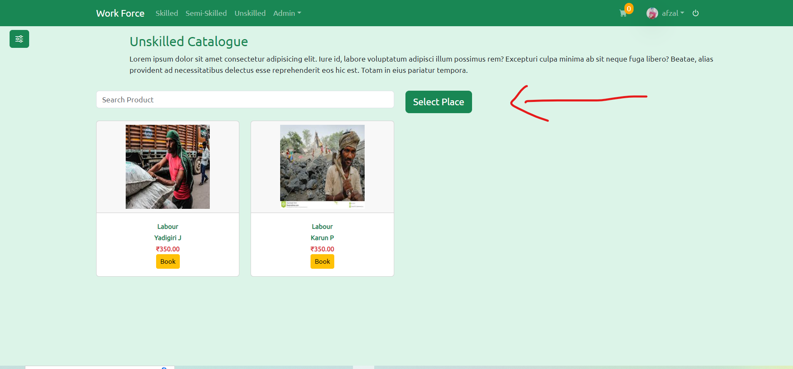

Slide 52
Future work
Payment Method: Integrate a secure payment method using Razor pay, providing users with a seamless and trusted transaction experience within the Workforce Management System.

Slide 53
.
Developer:
Name: Shaik Afzal Basha
Instituion: NIT Trichy
Qualification: M.Sc Computer Science
Email1: afzal180102@gmail.com
Email2: loyolite182849@gmail.com
Mobile Number:+91 8885561725

Slide 54


